Slide 1
Putting It All Together
Notes:
Hi, in this video we’re going to review the control structures we’ve learned so far and see how they can be put together to solve complicated Tracy problems.

Slide 2
Control Structures We’ve Learned
Control Structure | What does it do?
For Loops | Repeat code a specific number of times
If/Else Statements | Allow decisions to be made between any number of conditions
While Loops | Repeat code while a condition remains true
Notes:
We’ve learned many control structures that help us reduce, reuse, and recycle our code. We can use for loops, if/else statements, and while loops to write more effective code.

Slide 3
More Things We’ve Learned
Control Structure | What does it do?
Functions & Parameters | Group commands together to be called with a single line of code; parameters can alter commands
Variables | Store values that can be used and altered
Notes:
We’ve also learned some ways to write more sophisticated code by using functions, parameters, and variables.
All of these components can be used in conjunction with one another to allow us to write concise programs that solve complex problems.

Slide 4
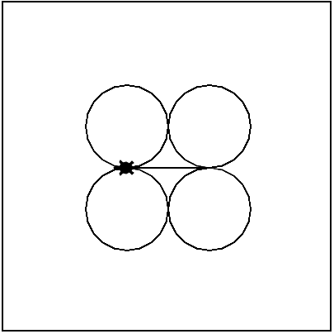
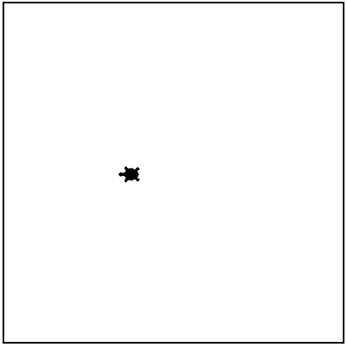
Tracy Command: clear
clear()
Used to remove any marks Tracy has left on the canvas
clear()
Notes:
Here’s one last new Tracy command that can be helpful when writing complex programs.
The clear command can be used to wipe the screen clean of any markings that Tracy has left so far. Using this command will not alter Tracy’s direction or position. It will simply remove any of the trails she has left prior to the command being called.

Slide 5
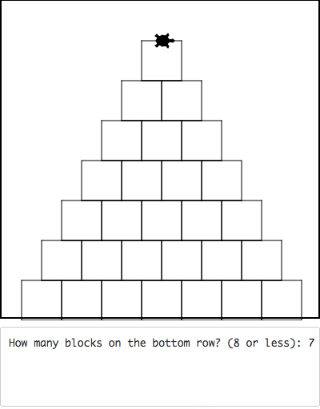
Example #1: Block Pyramid
Write a program that asks the user how many blocks they want on the bottom row of a pyramid and then draws blocks stacked in a pyramid formation, centered on the bottom of the canvas.
Notes:
Let’s look at our last Tracy example. It’s a tricky one but we have all the knowledge we need to be able to solve the challenge.
In this example, we want Tracy to draw a pyramid of squares centered on the bottom of the canvas where a user gives us the number of blocks in the bottom row. Let’s do some planning before we head to coding.

Slide 6
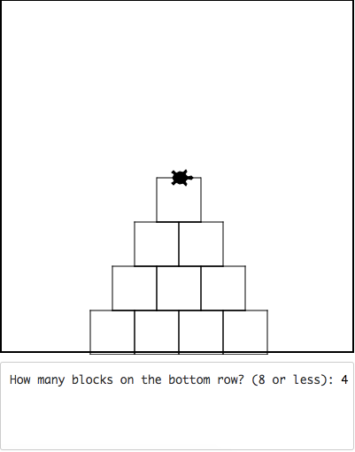
Example #1: Block Pyramid
Step 1: Tracy’s x-position
Each block has sides of 50 pixels
Number of blocks matters!
7 blocks * 50 pixels = 350 pixels
(175 pixels on each side)
4 blocks * 50 pixels = 200
(100 pixels on each side)
Keep track of number of blocks!
Equation for Starting Point X- Value:
-((num_blocks*50) /2)
Notes:
Our first challenge is determining where Tracy should be positioned in the x-direction for each row of blocks.
(Click for label) The first thing that is important to know is that each block has sides of length 50.
(Click for red box and label) In this situation, the user has chosen 7 blocks to comprise the bottom row. If there are 7 blocks and they are each 50 pixels wide, the total width of the row of blocks is 350 pixels. We want to center this row on the bottom of the canvas so to find the x-value, we need half of the blocks to be on the right side of the y-axis and half to be on the left. If the whole row is 350 pixels, this means that there are 175 pixels on each side of the y-axis.
(Click for red box, image, and label) Now if instead the user chose 4 blocks for the bottom row, this would mean that there are 4 blocks times 50 pixels each which gives us 200 pixels for the entire row, with 100 pixels on each side of the y-axis.
(Click for label and arrows) We just need to make sure that we have a variable that records how many blocks are in the bottom row so we can subtract one from that value each time we move up a row.
(Click for equation label) We can write a standard equation for the x-axis starting point that will be able to be used for any number of blocks. Our equation is number of blocks times block length (which is 50) divided by 2. This entire number must be negative so that Tracy is placed on the left side of the canvas.

Slide 7
Example #1: Block Pyramid
Step 2: Tracy’s y-position
Bottom of canvas is -200 on Y-axis (more negative as you move down)
Add height of block (50) * number rows to the -200 starting position at bottom of canvas
Equation for Y- Value:
-200 + (50 * row_value)
-200 + (50*0) = -200
-200 + (50*1) = -150
-200 + (50*2) = -100
Notes:
We then need to determine Tracy’s y-value as we move up each row. Let’s first recall how the y-axis values are distributed. The Y-axis starts at 200 at the top of the canvas and gets more negative as it goes down to -200 at the bottom of the canvas. Let’s write a generic equation that can be used to determine the y-value for each row.
(Click for equation, label, and red box) We need to take the bottom y-value, which is -200 and add the block height times the number of block rows because our y-value will get more positive as the pyramid grows and we get closer to the top of the canvas. So our bottom y-value is -200 + (50 * 0) which means the y-value is just -200.
(Click for red arrow and label) When we move to the next row, our y-value becomes -200 + (50* 1) which is -150.
(Click for red arrow and label) When we move to the next row, our y-value becomes -200 + (50 * 2), which is -100.
Let’s put all this together in our code editor.

Slide 8
Commands Learned this Lesson
Command | What does it do?
clear() | Removes any marks Tracy has left on the canvas without turning or moving her
Notes:
In this lesson, we explored how we can use control structures together in order to create more concise and advanced programs. We also learned about the clear command that can be used to clear a screen after Tracy has left markings. Use all the information you’ve learned so far to solve our most difficult Tracy challenges yet!

